Slide 1
After human resources…….
Larry Stybel. lstybel@stybeabody.com

Slide 2
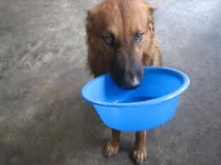
WANT THE SLIDES AND THE MP3?

Slide 3
Goals
Do a case.
Discuss what HR was, what it is, and what it needs to be for you to make a positive contribution and have a good career.
What skills do you need to cultivate?
What political alliances do you need to make?

Slide 4
CASE

Slide 6
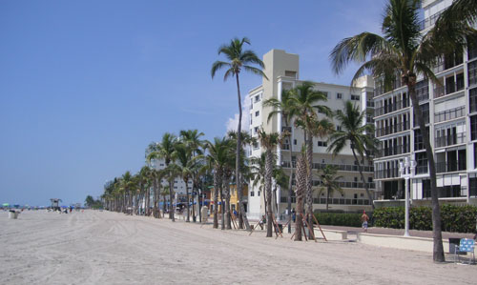

Slide 7
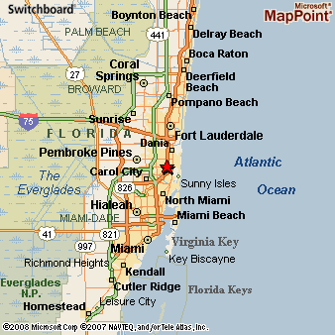

Slide 10
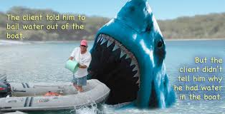
WHAT IS THE PROBLEM HERE?

Slide 11
WHAT’S THE DILEMMA?

Slide 12
A situation in which a difficult choice has to be made between two or more alternatives, esp. equally undesirable ones.

Slide 13
To Be ….Or Not To Be.
Pour Taxpayer Money Into Helping People Deal with Hurricane Sandy and We Increase the National Debt; Fail to Help People and We Increase Voter Resentment.
Help France in Its Military Operation And We Risk Increasing the Probability of Terrorism in the U.S.; Fail to Help France and We Turn Our Backs on an Ally.

Slide 15
http://www.nbcmiami.com/news/local/Hallandale-Beach-Lifeguard-Fired-For-Leaving-His-Zone-For-Rescue-161372785.html

Slide 16
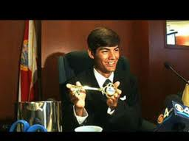

Slide 17
RESULT
Lost multi year contract $330K each year x9 = 3 million relationship.
Supervisor Lost Job.
Fired Lifeguard a Hero.
Jeff Ellis Management Reputation has a “Brand” that may impact customer sales, customer retention.
Jeff Ellis Management has a Brand that may make it hard to attract the best talent.

Slide 19
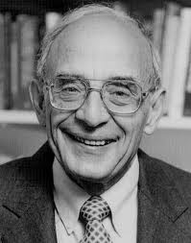
Argyris Technique

Slide 20
For more information
http://www.stybelpeabody.com/newsite/pdf/argyristechniques.pdf

Slide 21
HR THROUGH THE YEARS
Rose as a help in helping make people make the shift from farming-oriented jobs to industrial-oriented jobs.
Focus on consistency, systems, and standardization.
“Attract, retain, and motivate employees.”

Slide 22
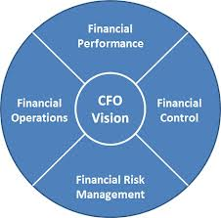
“LOGICAL” ALLIANCE

Slide 23
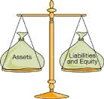
HR IS UNBALANCED IN ITS VALUE TO THE COMPANY.

Slide 24
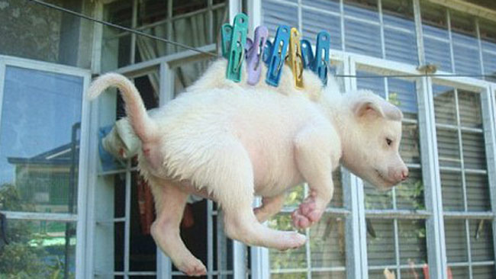
WHAT’S BEEN YOUR EXPERIENCE?

Slide 25
GETTING BEYOND TRADITIONAL HR
If you don’t articulate the new value proposition, nobody else will.

Slide 26
THINGS HAVE CHANGED BIG TIME.
“employees” once meant W-2.
“employees” should be replaced with “attract, retain, and motivate” those who influence customers: W-2, 1099, and even customers.

Slide 28
Power
Used to be Top-Down.
Now is Top-Down AND Bottom-Up. (Hallandale)
This puts HR more aligned with marketing since employees communicate with their networks via social media.
VP of HR at Southwest Airlines reports through the Marketing Function.

Slide 29
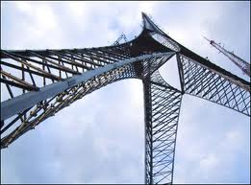
STRUCTURE

Slide 30
Hertzberg Hygiene Factors
Compensation
Benefits
Health & Safety Compliance

Slide 31
Hertzberg’s Motivational Factors
Organization Development
Recruitment
Training & Development

Slide 32
NEW DEFINITION OF WHAT WE DO.

Slide 33
Attract, Retain, and Motivate the People that touch our customers.
Effectiveness measured by Customer Loyalty Index of something similar.

Slide 34
Skill Sets
Ability to see things from both sides of the basic accounting balance sheet.
Open systems thinking (e.g. Hallandale Case).
Help management recognize and manage dilemmas (e.g. Hallandale Case).

Slide 35
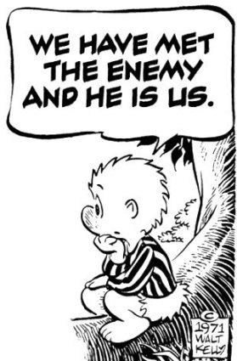

Slide 36
What Needs to Be Done
Self Assess Your Skills and What You Need to Survive in this New World: unlearning is MUCH harder than learning!
Prepare to articulate to the CEO that “I could do so much more for our company…….”

Slide 37
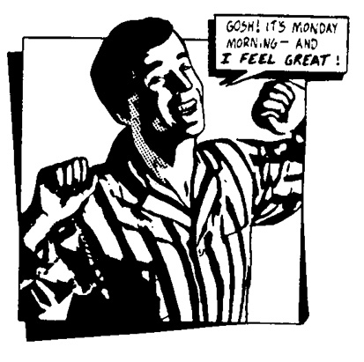
What Will You Do To Help Your Company and Yourself?

Slide 38
SUMMARY
Hallandale Case to illustrate Argyris Technique and a way to improve predictive validity of hiring.
What HR was and where it needs to go.
Rebrand, reposition, and new power.
Unlearn old ways while learning new.

