Slide 1
AFTER RETAINED SEARCH
Larry Stybel, Suffolk University and Stybel Peabody Assoc.

Slide 2
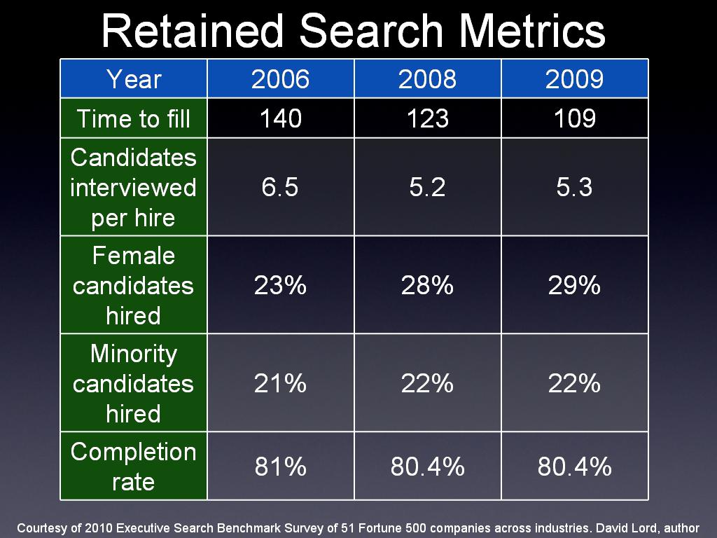

Slide 3


Slide 4
Hallandale Beach Case.
Overview of the Retained Search Industry.
Review the Hallandale Beach Case and how you can use the lessons learned.
What will come after retained search?

Slide 5


Slide 6


Slide 7
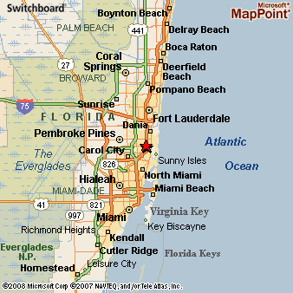

Slide 8


Slide 9


Slide 10
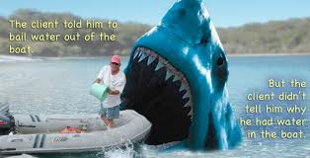
WHAT IS THE PROBLEM HERE?

Slide 11


Slide 12
http://www.nbcmiami.com/news/local/Hallandale-Beach-Lifeguard-Fired-For-Leaving-His-Zone-For-Rescue-161372785.html

Slide 13
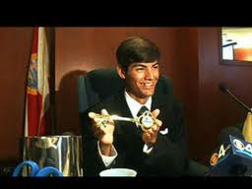

Slide 14
RESULT
Lost multi year contract $330K each year x9 = 3 million relationship.
Supervisor Lost Job.
Fired Lifeguard a Hero.
Jeff Ellis Management Reputation has a “Brand” that may impact customer sales, customer retention.
Jeff Ellis Management has a Brand that may make it hard to attract the best talent.

Slide 15


Slide 16
SUMMARY
Simple Case, Yet…….

Slide 17
Give me your business cards for a copy of the Argyris Technique and references.

Slide 18


Slide 19

AFTER RETAINED SEARCH

Slide 20

Your Experiences With Retained Search?

Slide 21
The Industry
Retained vs. Contingency vs. In-house.
Confidentiality.
Transparent Process.

Slide 22


Slide 23


Slide 24


Slide 25
Industry Structure
5,000 plus firms: name brand vs. trust.
Impact of Linkedin.com
Impact of erosion of company loyalty/assignment mentality.
Size can be both a blessing and a curse.

Slide 26
Industry Ethics
Model does not work: Heidrick Study.
“We warrant our services.”
“We examine the market for you….”
We present qualified candidates for the panel.
We check references thoroughly.

Slide 27
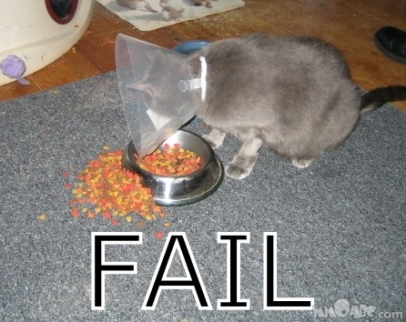
Classic Retained Search

Slide 28
Heidrick & Struggles
http://www.stybelpeabody.com/newsite/pdf/heidrickresearch.pdf

Slide 29
THE STRUCTURE OF THE BRAIN
http://www.stybelpeabody.com/newsite/pdf/argyris_technique.pdf

Slide 30
A final problem with Search

Slide 31

A Transactional Service

Slide 32
PLATFORMS FOR SUCCESS
HomeFind a Therapist
FindFind a Therapist
Find a Psychiatrist
Find a Therapy Group
Find a Treatment Facility
Do I Need Therapy? ProfessionalsTherapist Login
Therapist Sign-Up
Topic Streams
Addiction
Aging
Animal Behavior
Anxiety
Autism
Behavioral Economics
Child Development
Cognition
Creativity
Depression
Diet Eating Disorders
Education
Environment
Ethics and Morality
Evolutionary Psychology
Gender
Happiness
Health
Integrative Medicine
Intelligence
Law and Crime Media
Memory
Neuroscience
Parenting
Personal Perspectives
Personality
Philosophy
Politics
Procrastination
Psych Careers
Psychiatry Race and Ethnicity
Relationships
Resilience
Self-Help
Sex
Sleep
Social Life
Spirituality
Sport and Competition
http://www.psychologytoday.com/blog/platform-success

Slide 33


Slide 34
ASK FOR SEARCH AND YOU GET SEARCH
Ask for a package that includes retained search and onboarding for the price of search.
The person who did the search should also do the onboarding.
The Warranty should not be “in the job” in nine months but gets an overall performance review of “meets job expectation” at the one year anniversary.

Slide 35
SUMMARY
Hallandale Beach Case.
Espoused versus In Use Sector of Brain to improve predictive validity of job interviews.
The Search Industry and future directions.

Slide 36


Slide 37


Slide 38
Business Cards or
For copies of these slides: lstybel@stybelpeabody.com

