Slide 1
BEFORE “TELL ME ABOUT YOURSELF.”
Larry Stybel

Slide 2
GOALS
Why this topic can help you kill your competition.
Primary Research.
Secondary Research.
Brain Body Calisthenics.
Follow Up Techniques.

Slide 3
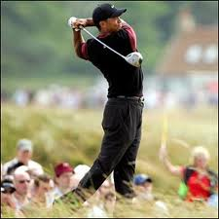

Slide 4
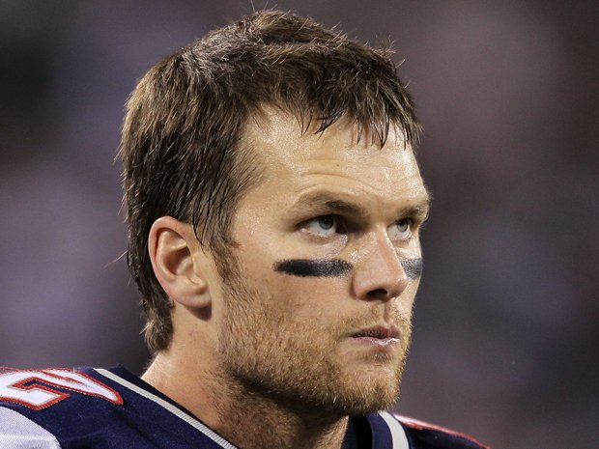

Slide 5
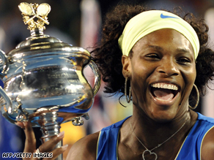

Slide 6

Healthy Competition is Good;
No Competition is Better.

Slide 7
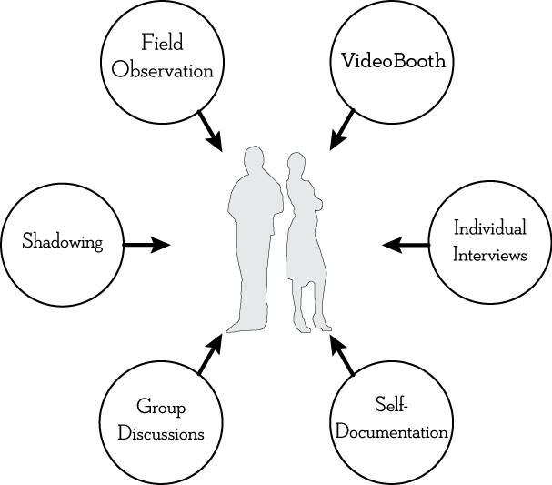
PRIMARY RESEARCH

Slide 8
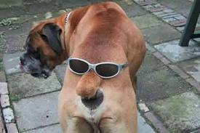
TURN THEIR RECRUITER
INTO YOUR BEST FRIEND.

Slide 9
You know your client better than me. I may or may not get the job. I do not want to alienate them and make you think, “I’ll never present this person to another client of mine again!” What do I need to know to avoid touching third rails.

Slide 10
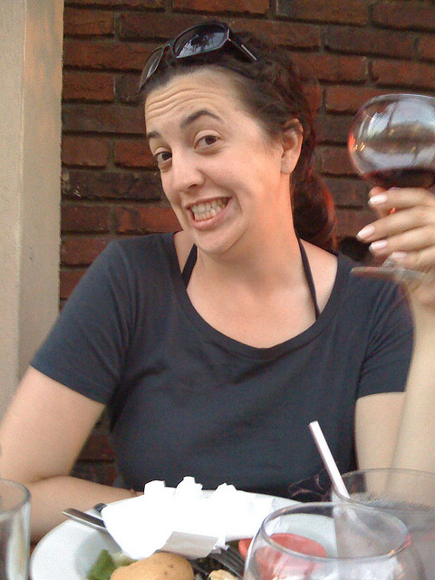
“There are no third rails, but………”

Slide 11


Slide 12
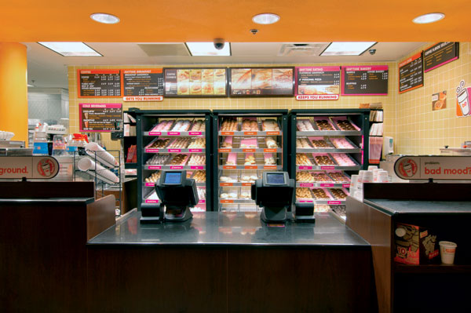

Slide 13
Two Types
Open Systems
Closed Systems (Dunkin’ Donuts)
Hospitals.
Universities.
Town Government.
Everything Else!!!

Slide 14
I have one question. On a scale of zero to ten, what number would you give to the following question: “I would recommend this company as a place to work if asked by a friend.”

Slide 15

WATCH their reaction!!!

Slide 16

0-3: openly hostile.

Slide 17
4-7: neutral

Slide 18

8-10: Advocate

Slide 19

Ask 4-6 Times

Slide 20

Dunkin Donuts Primary Research

Slide 21


Slide 22
Write some ideas to yourself how you might operationalize these ideas in your next interview.
Discuss with others.

Slide 23


Slide 24


Slide 25
PRIVATE COMPANY
Dnb.com
Lexis Nexis
News.google.com
Linkedin.com departures
Bbj.com

Slide 26
Exercise: Glassdoor.com
Southwestern Airlines and American Airlines are both in the commercial airline business; both are public companies; and both have headquarters in the Dallas-Ft. Worth region.
Glassdoor.com
Utube.com

Slide 27


Slide 28
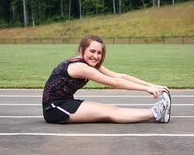
Brain Body Calisthenics.

Slide 29
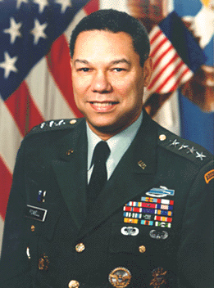

Slide 30


Slide 31
Prof. Amy Cuddy, Harvard B School
http://www.youtube.com/watch?v=Ks-_Mh1QhMc
Measured stable states of cortisone and testosterone levels.
Had males and females assume “power” positions for two minutes.
Had males and females assume “low power” positions for two minutes.

Slide 32
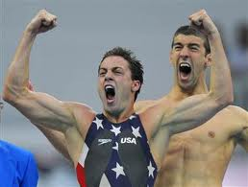
Larry in the Bathroom

Slide 33


Slide 34
How to Kill Your Competition
It starts before you walk into the interview room.
It requires discipline.
Primary Research
Secondary Research
Brain Body Calisthenics

Slide 35
Want a copy of these slides?
Want an mp3 of this talk?
Want a link to “Platform for Success,” the Stybel Peabody column on leadership in PSYCHOLOGY TODAY magazine?
Give me your business cards.

Slide 36
