Slide 1
How to use brain science to inform your response to “tell me about yourself.”

Slide 2
Three Goals
Write down you response to “tell me about yourself.”
Provide you with a new framework to respond to this question
Practice the new framework.

Slide 3


Slide 4


Slide 5


Slide 6
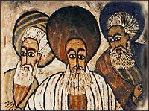

Slide 7


Slide 8
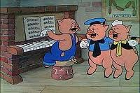

Slide 9


Slide 10


Slide 11


Slide 12


Slide 13


Slide 14


Slide 15
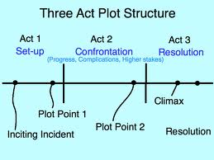

Slide 16


Slide 17


Slide 18


Slide 19


Slide 20
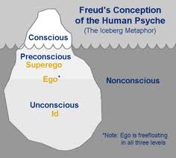

Slide 21


Slide 22


Slide 23


Slide 24

MILLER’S LAW:

Slide 25
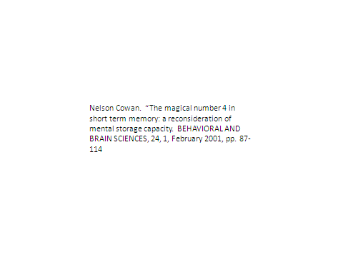

Slide 26
Listen to the Voice of the Market
Go to indeed.com
Find three technical or “soft” skills qualities important to jobs YOU are targeting.
The three should be “relatively” uncommon yet important to the employer.
You should be able to discuss your competence if questioned about it.

Slide 27
Your New Script: Tell Me About Yourself.
There are many qualified people in the market today and I consider myself one of them: but there are three things I believe might be of value to my next employer: (1) (2) (3).

Slide 28


Slide 29


Slide 30
SUMMARY AND CONCLUSIONS
“Tell Me About Yourself” is a question you need to answer well.
The person you are communicating with likes the number 3: you should like the number three.
We have given you a format which allows you to differentiate yourself without coming across as someone who is bragging.

Slide 31


Slide 32
For More Information
http://www.psychologytoday.com/blog/platform-success
http://www.stybelpeabody.com/newsite/leadership_resources.php

Slide 33


